Slide 1
Random Variables
Hubert Chan (Chapter 6)
[O1 Abstract Concepts]
[O2 Proof Techniques]
[O3 Basic Analysis Techniques]

Slide 2
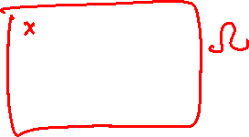
Random Variables
In many cases, we associate a value with each outcome of an experiment.
For instance,
consider the experiment of flipping a coin 10 times, each outcome can be associated with
the number of heads,
the difference between heads & tails, etc.
Each quantity above is called a random variable; note that its value depends on the outcome of the experiment and is not fixed in advance.

Slide 3
Formally speaking [O1]
With respect to an experiment,
a random variable is a function
from the set of possible outcomes Ω
to the set of real numbers.
NB. A random variable is characterised by the sample space of an experiment.

Slide 4
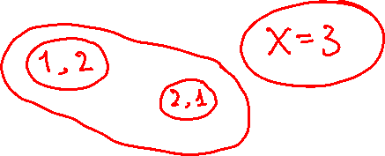
Example: Let X be the sum of the numbers obtained by
rolling a pair of fair dice.
There are 36 possible outcomes, each defines
a value of X (in the range from 2 to 12).
X
8
Sample
space
2,6
X
4
8
X
X
10
6
1,3
5,3
X
6,4
4,2
X
2
1,1

Slide 5
Random variables and events
A more intuitive way to look at the random variable X is to examine the probability of each possible value of X.
E.g., consider the previous example:
Let p(X=3) be the probability of the event that the sum of the two dice is 3.
This event comprises two outcomes, (1,2) and (2,1).
p(X=3) = 2/36.

Slide 6
Collection of Events Induced by a Random Variable
X = sum of numbers from rolling two dice
What is the sample space?
What is the collection of events induced by X?

Slide 7
Expected value
In the previous example, what is the expected value (average value) of X?
Out of the 36 outcomes,
(1,1): X=2
(1,2), (2,1): X=3
(1,3), (2,2), (3,1): X=4
(1,4), (2,3), (3,2), (4,1): X=5
(1,5), (2,4), (3,3), (4,2), (5,1): X=6
(1,6), (2,5), (3,4), (4,3), (5,2), (6,1):
X=7
(2,6), (3,5), (4,4), (5,3), (6,2): X=8
(3,6), (4,5), (5,4), (6,3): X=9
(4,6), (5,5), (6,4): X=10
(5,6), (6,5): X=11
(6,6): X=12
Expected value of X =
(2 + 3x2 + 4x3 + 5x4
+ 6x5 + 7x6 + 8x5 + 9x4
+ 10x3 + 11x2 + 12) / 36
= 7

Slide 8
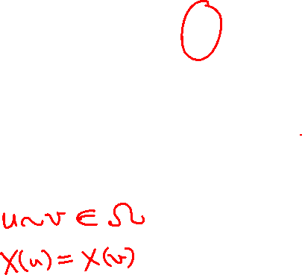
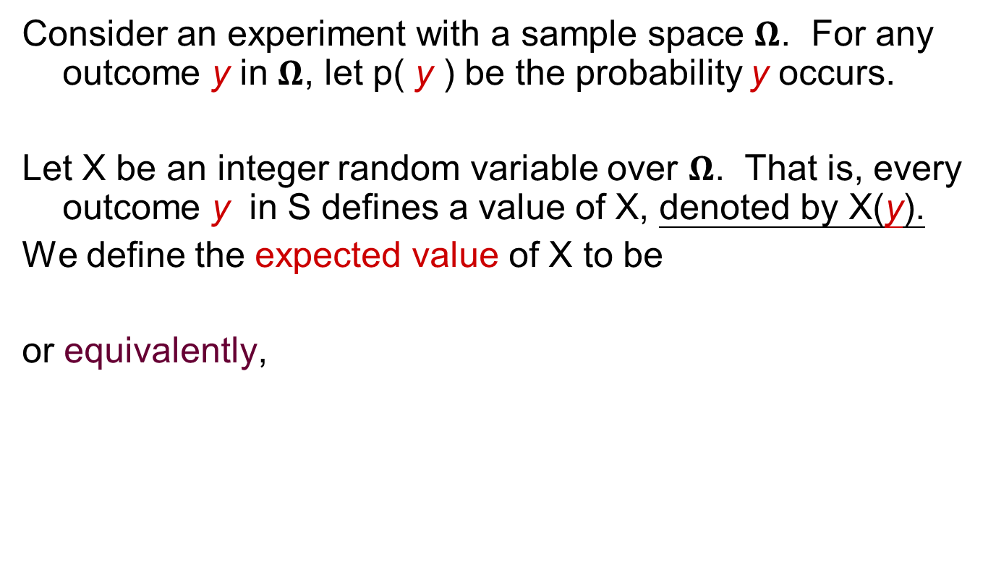

Definition
Consider an experiment with a sample space $Ω$. For any outcome y in $Ω$, let p( y ) be the probability y occurs.
Let X be an integer random variable over $Ω$. That is, every outcome y in S defines a value of X, denoted by X(y).
We define the expected value of X to be
or equivalently,
X: $Ω$ → Z

Slide 9
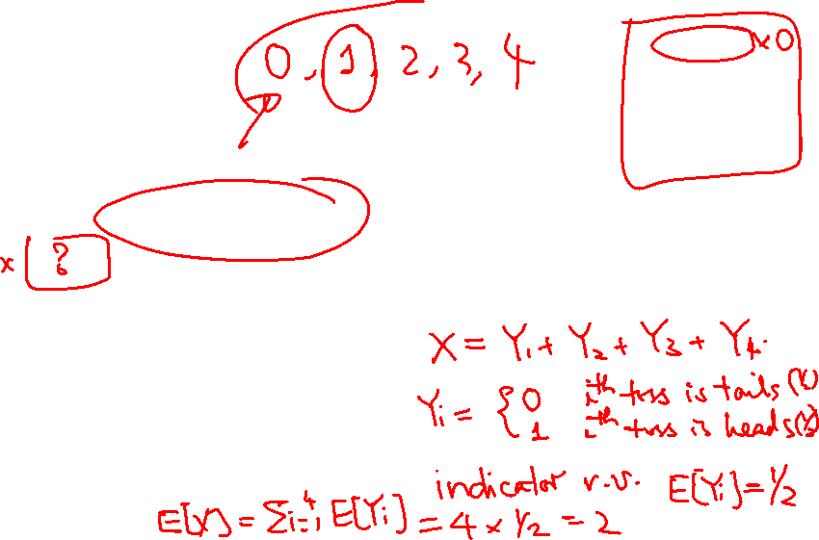
Example
What is the expected number of heads in flipping a fair coin four times?
1 x C(4,1) 1/2 (1/2)³
+ 2 x C(4,2) (1/2)² (1/2)²
+ 3 x C(4,3) (1/2)³ 1/2
+ 4 x (1/2)⁴
= 4/16 + 2 x 6/16 + 3 x 4/16 + 4 x 1/16
= 2
Prob [# of heads = 1]

Slide 10
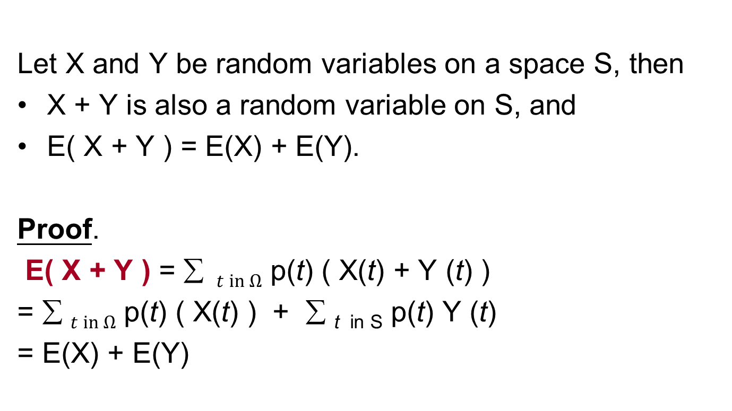
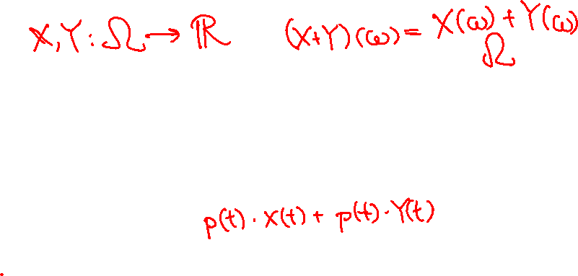
Useful rules for deriving expected values [O2]
Let X and Y be random variables on a space S, then
X + Y is also a random variable on S, and
E( X + Y ) = E(X) + E(Y).
Proof.
E( X + Y ) = ∑ $t in Ω$ p(t) ( X(t) + Y (t) )
= ∑ $t in Ω$ p(t) ( X(t) ) + ∑ _{t in S} p(t) Y (t)
= E(X) + E(Y)
outcome
Y
X

Slide 11
Useful rules for deriving expected values
Let X be a random variable on a space S, and let a be a real number. Then
aX is also a random variable on S, and
E( aX) = a E(X).
Proof.
E( aX ) = ∑ _{t in S} p(t) ( aX(t) )
= a ∑ _{t in S} p(t) ( X(t) )
= a E(X)

Slide 12
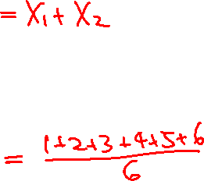
Example
Use the “sum rule” to derive the expected value of the sum of the numbers when we roll a pair of fair dice (denoted by X).
Suppose the dice are coloured red and blue.
Let X₁ be the number on the red die, and let X₂ be the number on the blue die.
E(X₁) = E(X₂) = 3.5
X = X₁ + X₂ . Thus, E(X) = E(X₁) + E(X₂) = 7

Slide 13
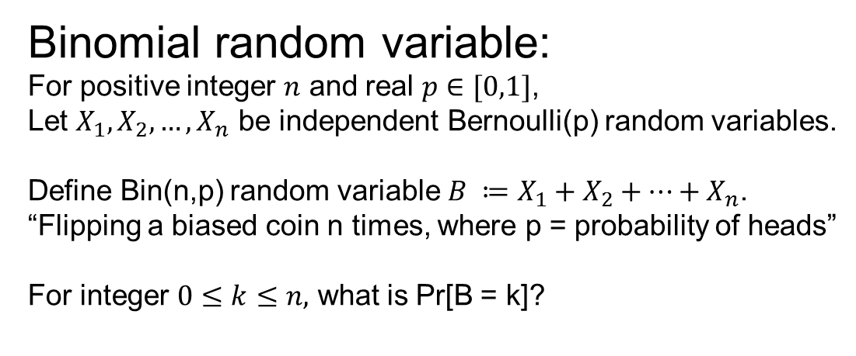
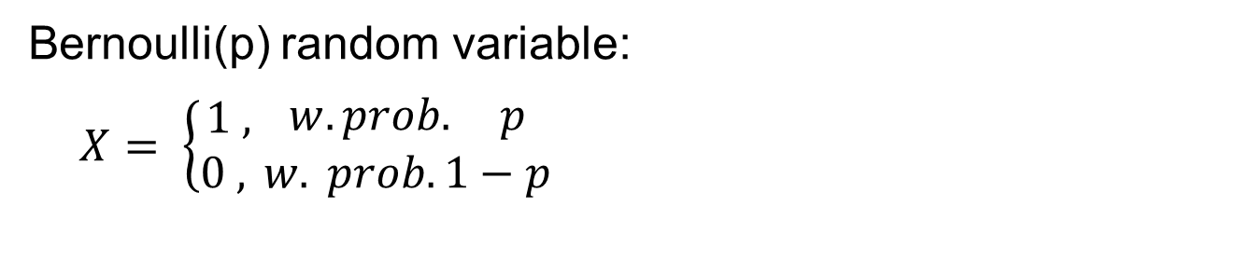
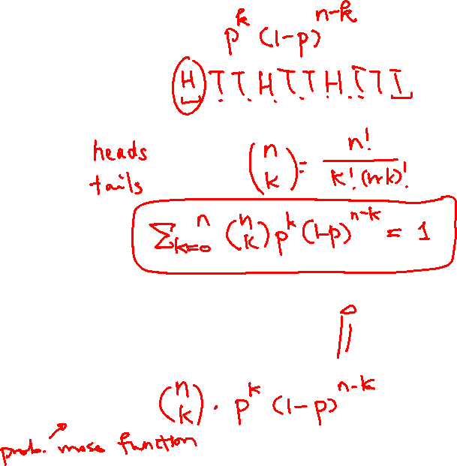
Binomial Distribution
Bernoulli(p) random variable:
$X= \left\{\begin{matrix}1 , \\ 0 , \end{matrix}\right.\begin{matrix}w.prob. p \\ w. prob. 1−p\end{matrix}$
Binomial random variable:
For positive integer $n$ and real $p∈[0,1]$,
Let $X_{1},X_{2},…, X_{n}$ be independent Bernoulli(p) random variables.
Define Bin(n,p) random variable $B ≔X_{1}+X_{2}+⋯+X_{n}$.
“Flipping a biased coin n times, where p = probability of heads”
For integer $0≤k≤n,$ what is Pr[B = k]?

Slide 14
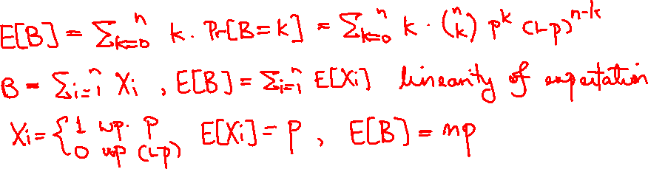
Exercise: Expectation of Bin(n,p)

Slide 15
What about product?
Let X and Y be two random variables of a space S.
Is E(XY) = E(X) E(Y)?

Slide 16
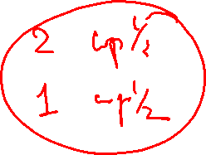
What about product?
Let X and Y be two random variables of a space S. Is E(XY) = E(X) E(Y)?
Example: Consider tossing a fair coin twice.
Associate head with 2 and tail with 1.
What is the expected value of the product of the numbers obtained in tossing a coin twice.
(1,1) → 1; (1,2) → 2; (2,1) → 2; (2,2) → 4
Expected product: (1+2+2+4) / 4 = 2.25
Expected value of 1st flip: (1+2) / 2 = 1.5
Expected value of 2nd flip: (1+2) / 2 = 1.5
Note that 2.25 = 1.5 × 1.5!

Slide 17
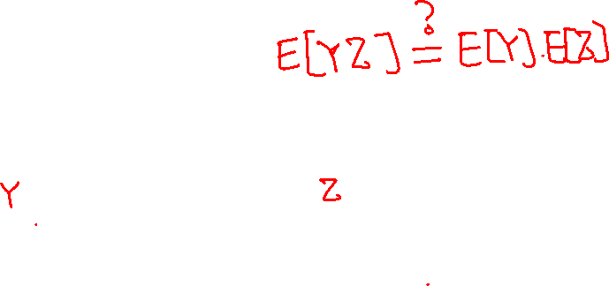
Counter Example
Consider the previous experiment again. Define a random variable X as follows:
X = (the first number) × (the sum of the two numbers)
(1, 1) → 1 × 2 = 2; (1, 2) → 1 × 3 = 3;
(2, 1) → 2 × 3 = 6; (2, 2) → 2 × 4 = 8
Expected value of X: (2+3+6+8) / 4 = 4.75
Expected value of the first number: 1.5
Expected sum: (2+3+3+4) / 4 = 3
4.75 ≠ 1.5 × 3
Why? Because the first number and the sum is not independent.

Slide 18
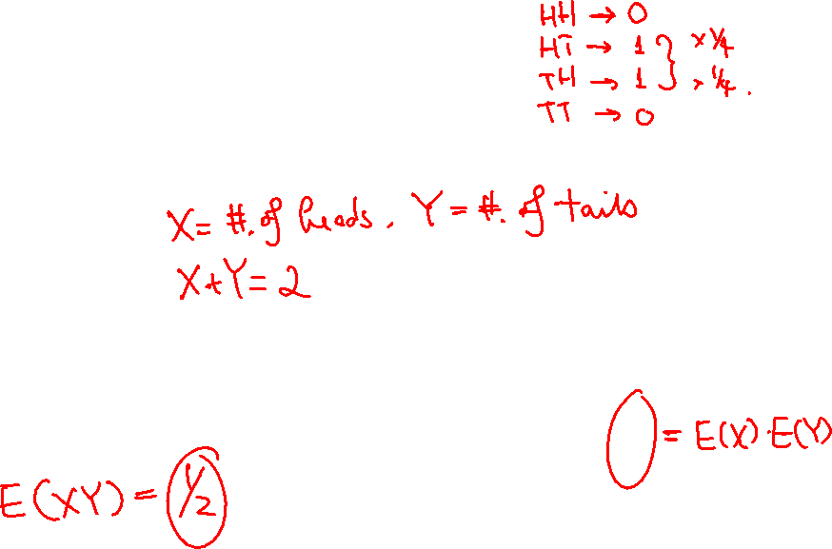
Counter Example
Consider the experiment of flipping a fair coin twice.
Expected (number of) heads = 1
Expected tails = 1
Expected heads × expected tails = 1
Expected (heads × tails) = 2 / 4 = 0.5

Slide 19
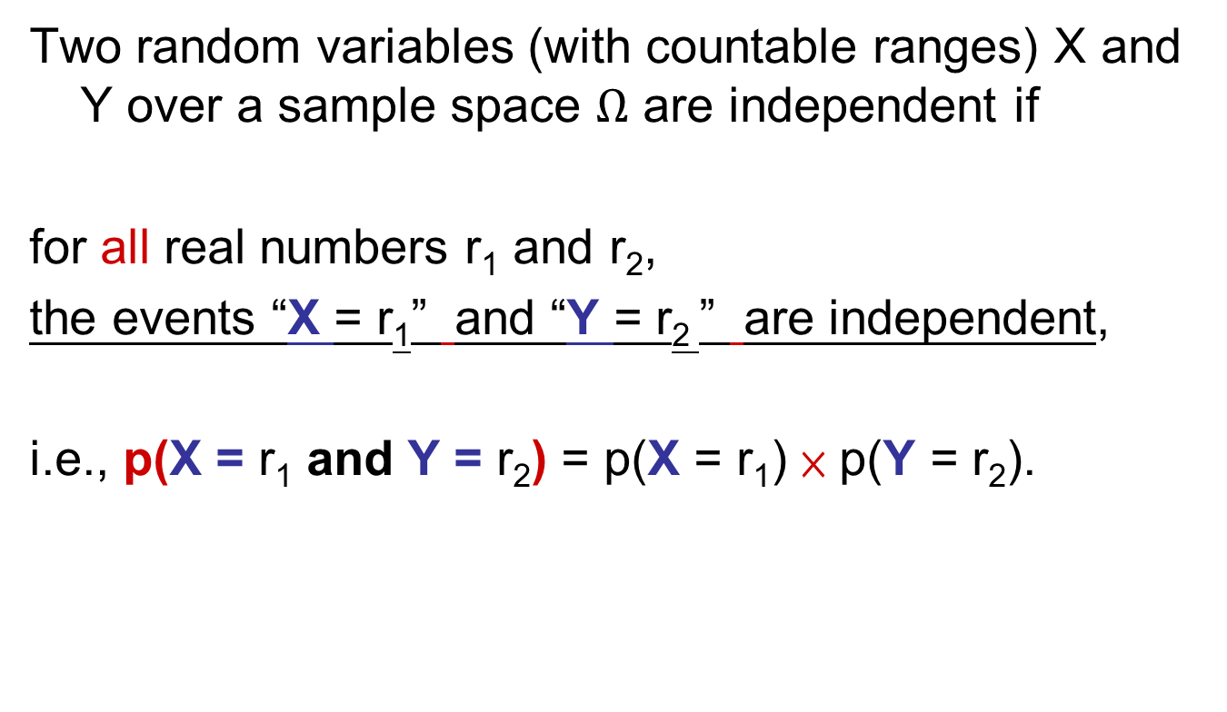
Independent random variables
Two random variables (with countable ranges) X and Y over a sample space $Ω$ are independent if
for all real numbers r₁ and r₂,
the events “X = r₁” and “Y = r₂ ” are independent,
i.e., p(X = r₁ and Y = r₂) = p(X = r₁) × p(Y = r₂).

Slide 20

Product rule
If X and Y are independent random variables on a space S, then E(XY) = E(X) E(Y).
What about the other direction?

Slide 21
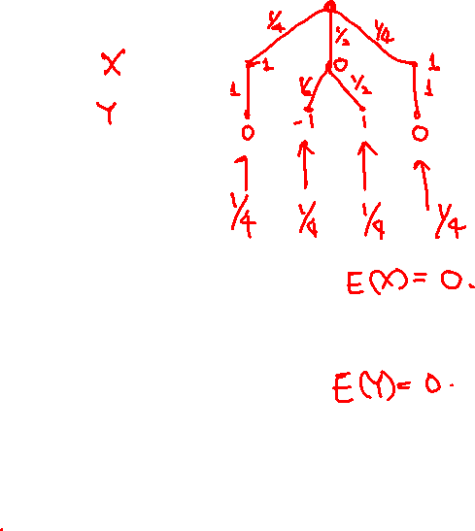
Product rule
If E(XY) = E(X) E(Y), can we say X and Y are independent?
No. Counter Example:
Define X as follows:
Define Y as follows (depending on X):
The product XY is always 0. We have E(X) = E(Y) = 0 and E(XY) = 0. Hence E(XY) = E(X) E(Y). However, X and Y are clearly dependent.

Slide 22
Infinite Sample Space
Consider the following network protocol.
Repeat
flip a biased coin which shows head with probability 1/4 and tail with probability 3/4;
if “head” then send a packet to the network;
until “sent”

Slide 23
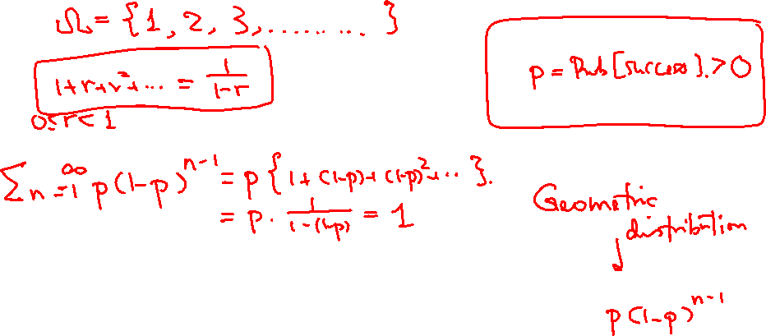
Infinite Sample Space
What is the sample space associated with the network protocol?
Let X = number of iterations used by the protocol.
What is the probability that X= n? Answer:
What is the E[X]? (See next page)

Slide 24
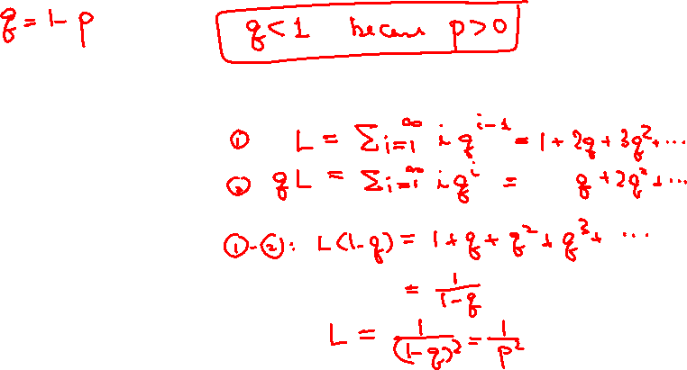
Infinite Sample Space [O3]
Let p be the probability of success within each trial.
Let q be the probability of failure within each trial.
∑ _{i=1 to ∞} (prob of sending the packet in the i-th trial) i
= ∑ _{i=1 to ∞} (q ^{i-1}p) i
= p ∑ _{i=1 to ∞} (q ^{i-1}) i
= p / (1 - q)²
= 1 / p = 4

Slide 25
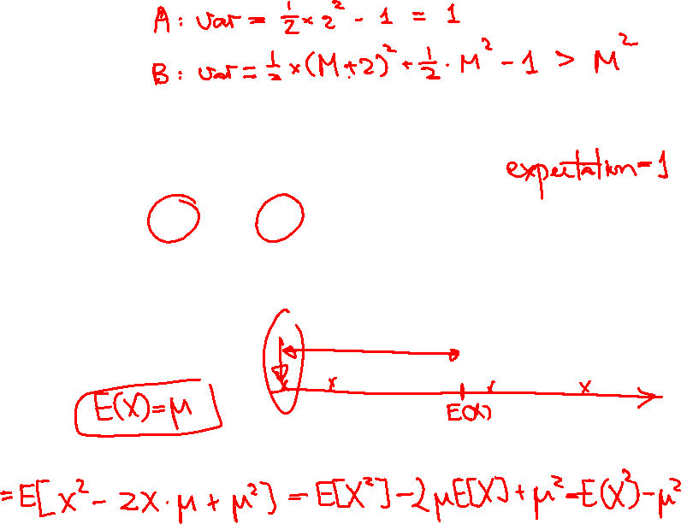
Variance
Example. Which game is more preferable?
With probability 0.5, win $2; with probability 0.5, win $0.
With probability 0.5, win $1,000,002; with probability 0.5, lose $1,000,000.
(B) is more “uncertain’’.
Var[X] = E[(X – E(X))²] = E[X²] – E[X]²

